Slide 1
Dynamic Head: Unifying Object Detection Heads with Attentions
Xiyang Dai et al - Microsoft Redmond CVPR 2021

Slide 2
Motivation
Three main perspectives of an object detection head:
Scale-awareness: detect objects with different scales co-existing in an image.
Spatial-awareness: detect objects having different shapes, rotations, and locations under different viewpoints.
Task-awareness: express objects in various representations (e.g., bounding box, center, and corner points) that own totally different objectives and constraints.

Slide 3
Motivation
Previous works only focus on solving separate perspective:
Scale-awareness: image pyramid, feature pyramid, pyramid convolution…
Spatial-awareness: increased model size, data augmentation, dilated convolution, deformable convolution…
Task-awareness: task-specific branches (single-stage detectors), combined object bounding box & segmentation mask (Mask R-CNN), center/key-point representation (FCOS, ATSS, RepPoints)...
Notes:
FCOS: Fully Convolutional One-Stage Object Detection
ATSS: Adaptive Training Sample Selection
RepPoints: Representative Points

Slide 4
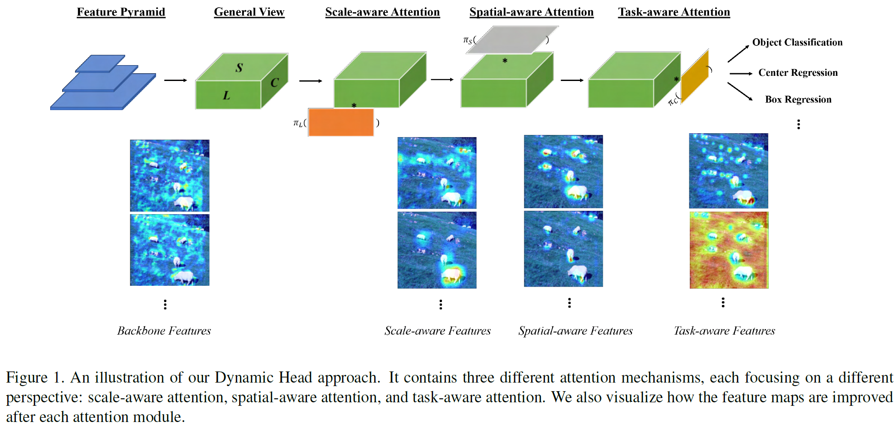
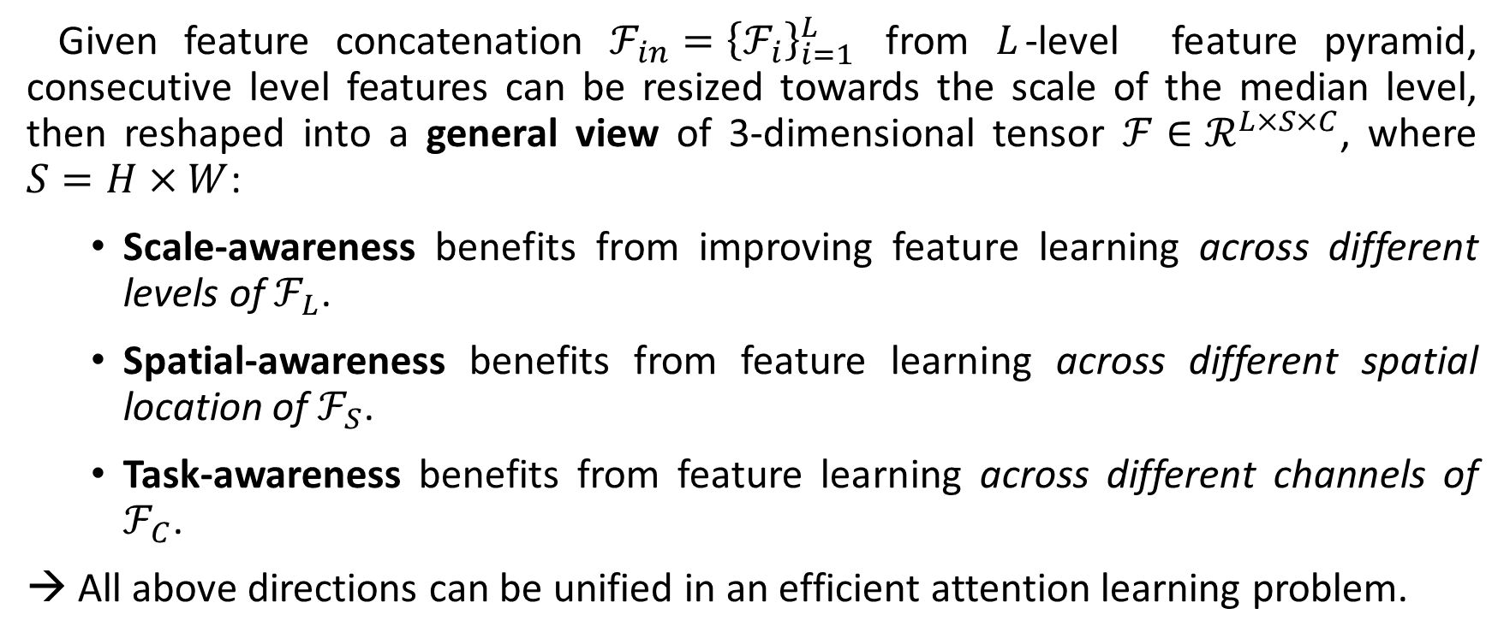
Motivation
Given feature concatenation $ℱ_{in}={\left\{ℱ_{i}\right\}}_{i=1}^{L}$ from $L$-level feature pyramid, consecutive level features can be resized towards the scale of the median level, then reshaped into a general view of 3-dimensional tensor $ℱ∈ℛ^{L×S×C}$, where $S=H×W$:
Scale-awareness benefits from improving feature learning across different levels of $ℱ_{L}$.
Spatial-awareness benefits from feature learning across different spatial location of $ℱ_{S}$.
Task-awareness benefits from feature learning across different channels of $ℱ_{C}$.
→ All above directions can be unified in an efficient attention learning problem.

Slide 5
Dynamic Head
Notes:
After passing through scale-aware attention module, the feature maps become more sensitive to the scale differences of foreground objects.
After passing through spatial-aware attention module, the feature maps become sparser and more focused on discriminative spatial locations of foreground objects.
After passing through task-aware attention module, the feature maps re-form into different activations based on the requirements of different down-stream tasks.

Slide 6
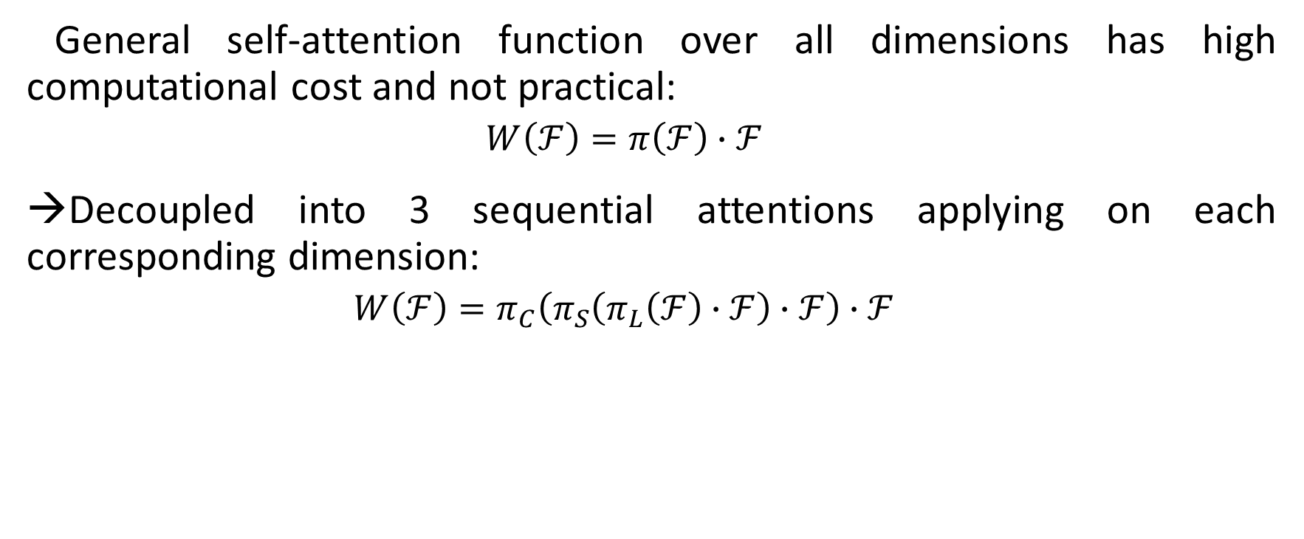
Dynamic Head
General self-attention function over all dimensions has high computational cost and not practical:
$$W\left(ℱ\right)=π\left(ℱ\right)∙ℱ$$
Decoupled into 3 sequential attentions applying on each corresponding dimension:
$$W\left(ℱ\right)=π_{C}\left(π_{S}\left(π_{L}\left(ℱ\right)∙ℱ\right)∙ℱ\right)∙ℱ$$

Slide 7
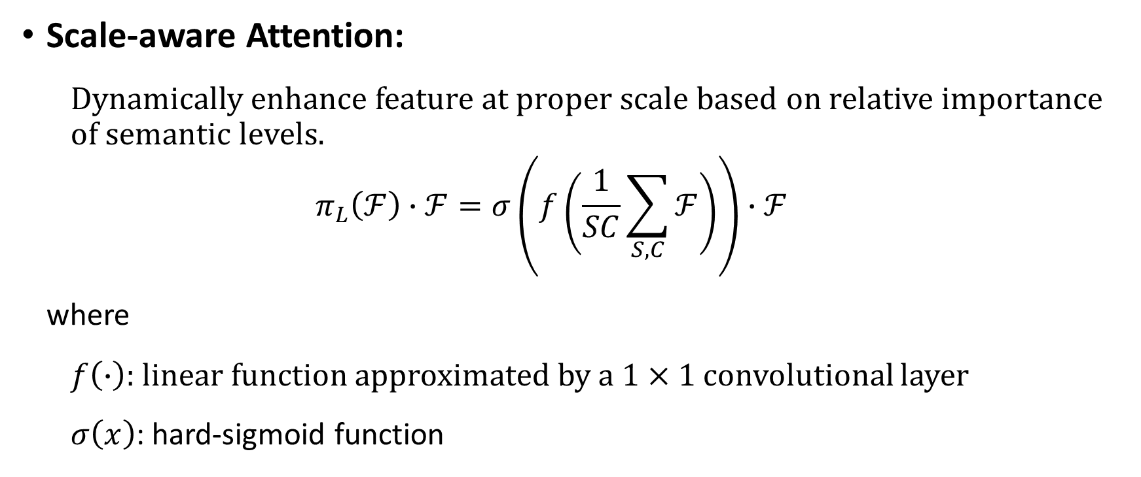
Dynamic Head
Scale-aware Attention:
Dynamically enhance feature at proper scale based on relative importance of semantic levels.
$$π_{L}\left(ℱ\right)∙ℱ=σ\left(f\left(\frac{1}{SC}\sum_{S,C}{ℱ}\right)\right)∙ℱ$$
where
$f\left(∙\right)$: linear function approximated by a $1×1$ convolutional layer
$σ\left(x\right)$: hard-sigmoid function
Notes:
Dynamically fuse features of different scales based on their semantic importance

Slide 8

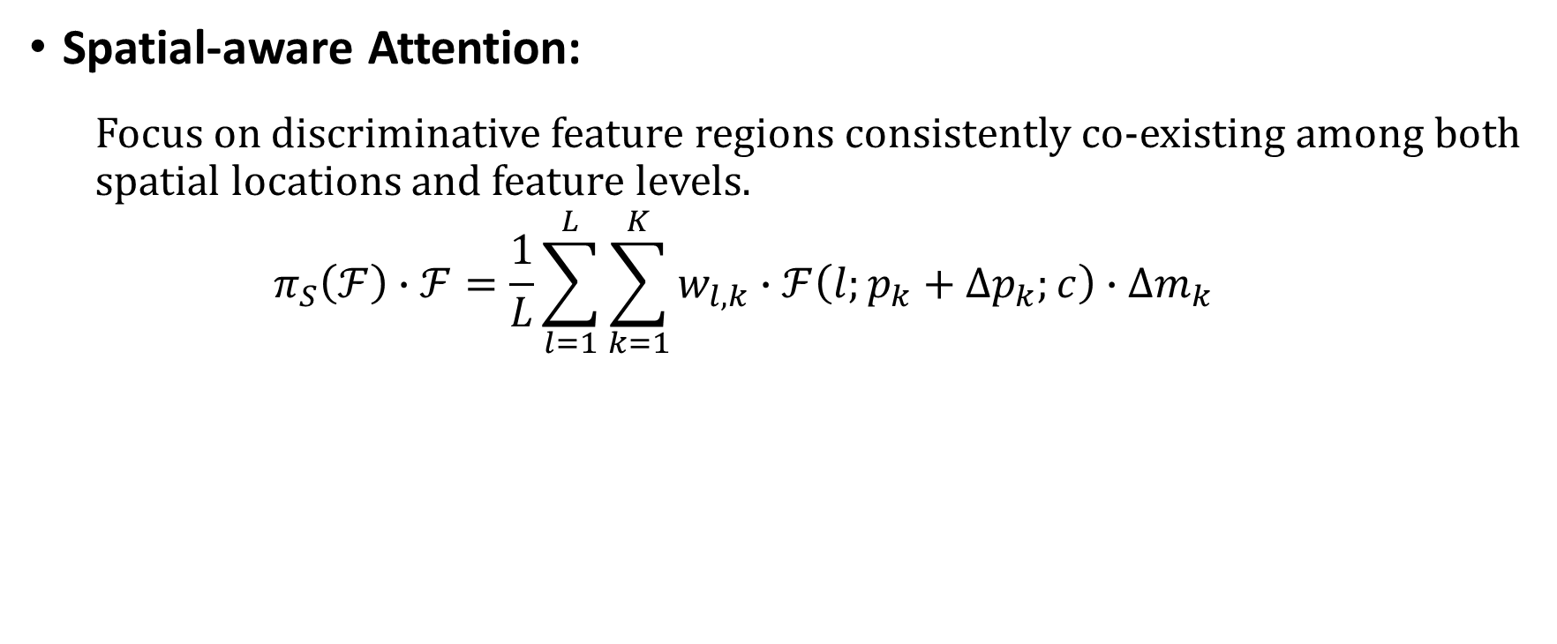
Dynamic Head
Spatial-aware Attention:
Focus on discriminative feature regions consistently co-existing among both spatial locations and feature levels.
$$π_{S}\left(ℱ\right)∙ℱ=\frac{1}{L}\sum_{l=1}^{L}{\sum_{k=1}^{K}{w_{l,k}∙ℱ\left(l;p_{k}+∆p_{k};c\right)∙∆m_{k}}}$$
Learnable importance scalar at $p_{k}$
Deformable convolution

Slide 9
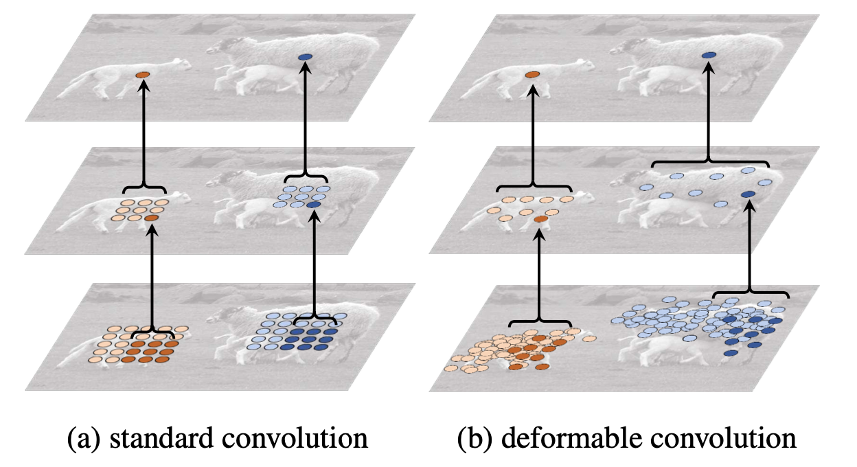
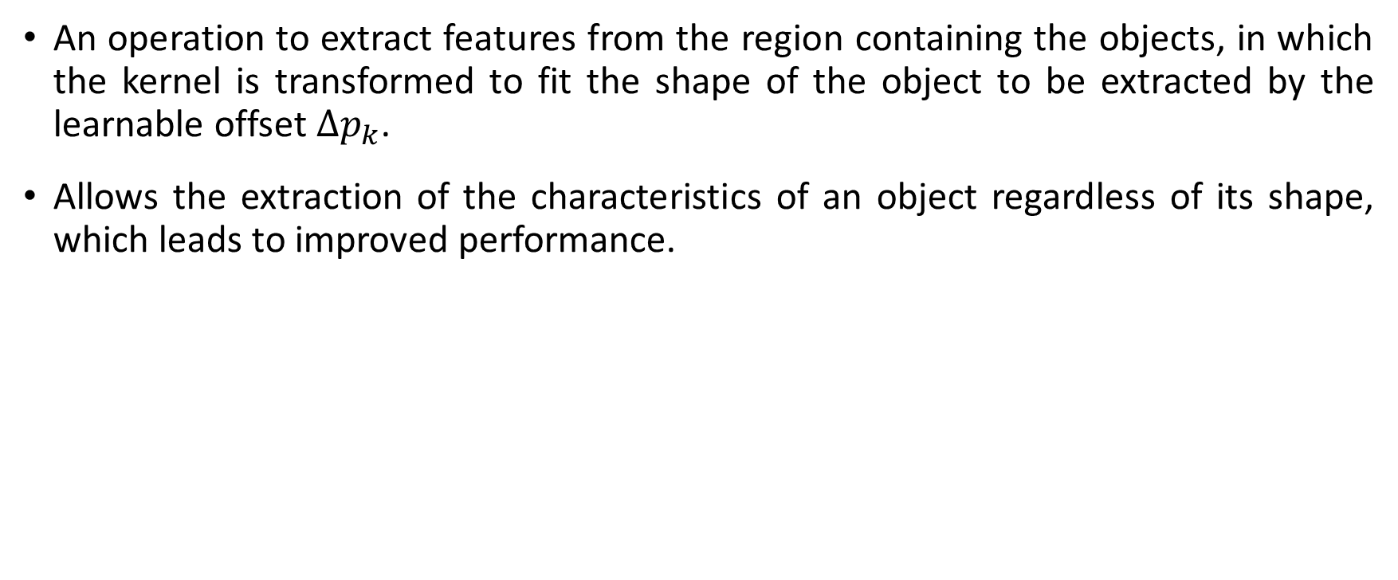
Deformable Convolution
An operation to extract features from the region containing the objects, in which the kernel is transformed to fit the shape of the object to be extracted by the learnable offset $∆p_{k}$.
Allows the extraction of the characteristics of an object regardless of its shape, which leads to improved performance.

Slide 10
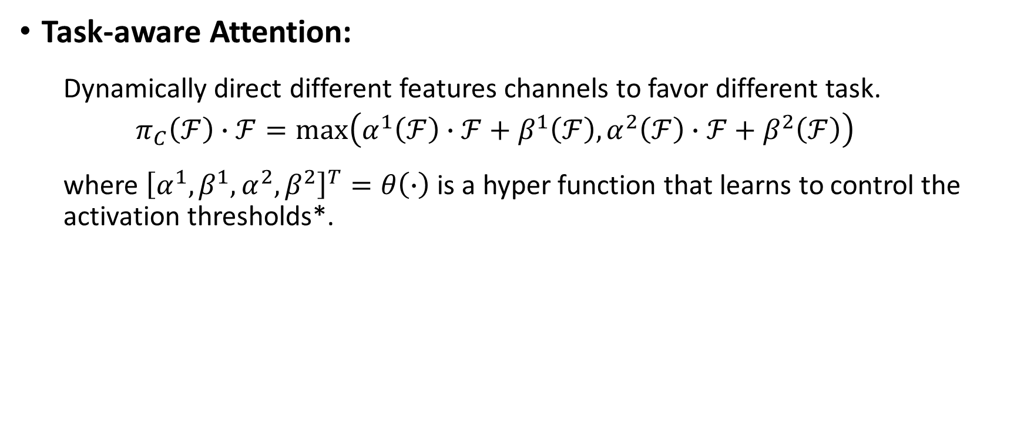
Dynamic Head
Task-aware Attention:
Dynamically direct different features channels to favor different task.
$$π_{C}\left(ℱ\right)∙ℱ=max\left(α^{1}\left(ℱ\right)∙ℱ+β^{1}\left(ℱ\right),α^{2}\left(ℱ\right)∙ℱ+β^{2}\left(ℱ\right)\right)$$
where ${\left[α^{1},β^{1},α^{2},β^{2}\right]}^{T}=θ\left(∙\right)$ is a hyper function that learns to control the activation thresholds*.
* Yinpeng Chen et al – Microsoft Redmon, Dynamic relu, ECCV 2020.

Slide 11
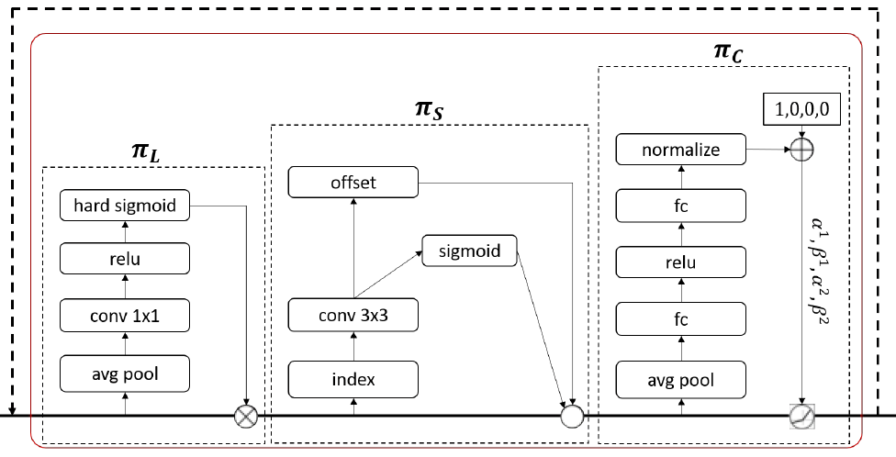
Implementation
DyHead block can be stacked multiple times:
Implementation of each attention module

Slide 12
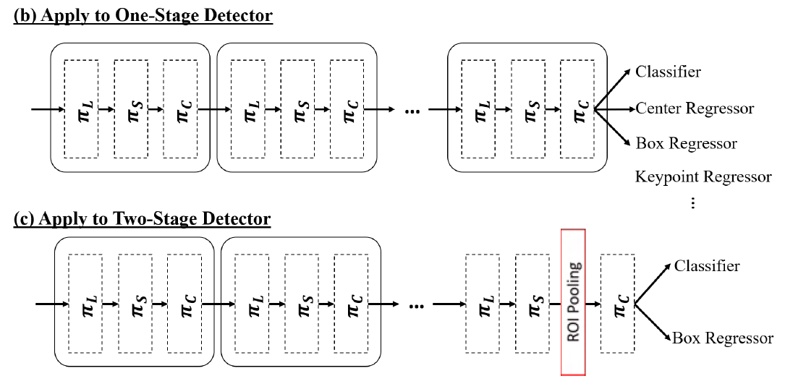
Implementation
DyHead block can be integrated into existing detectors to improve their performance:
Notes:
In one-stage detectors, only attach one unified branch and then append various types of predictions to the end of head.
In two-stage detectors, task-aware attention is used to replace original fully connected layers.

Slide 13
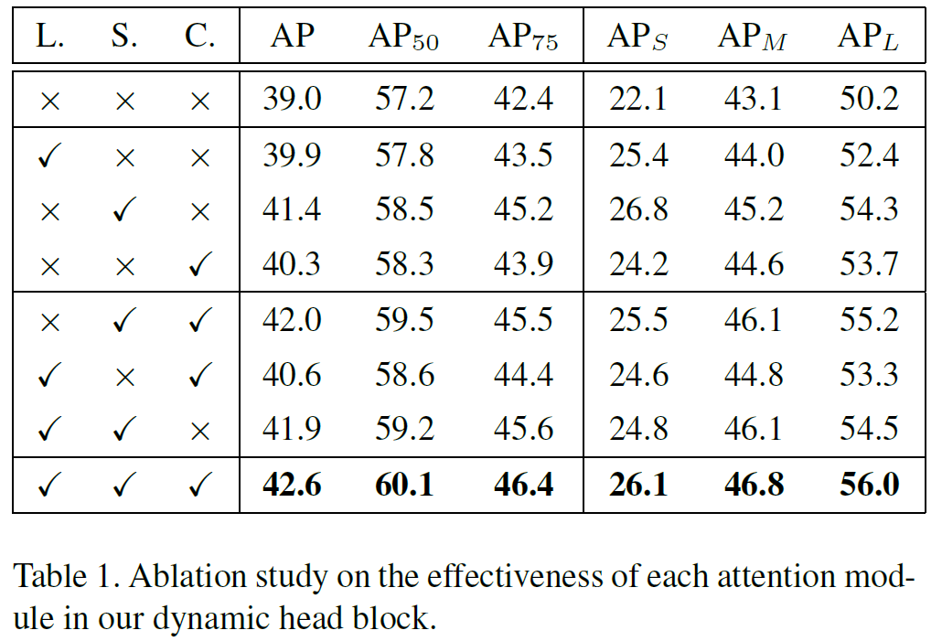
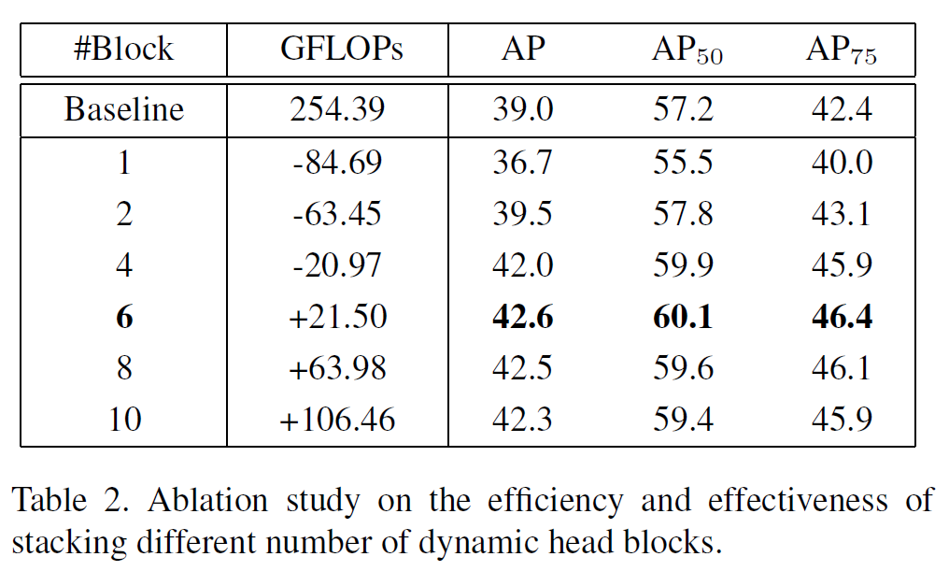
Experiment Results

Slide 14
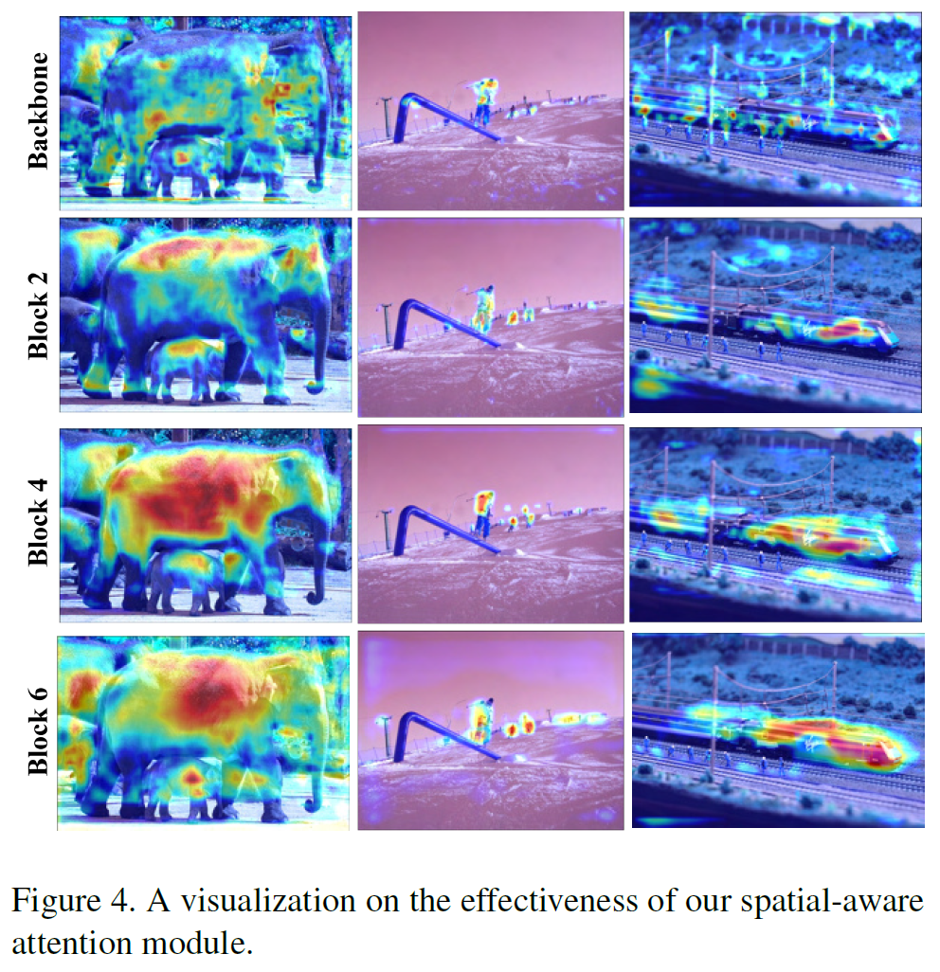
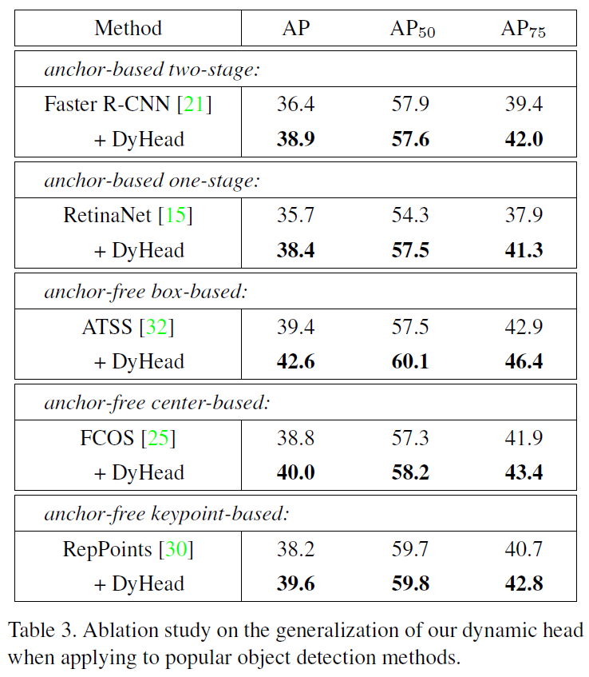
Experiment Results

Slide 15
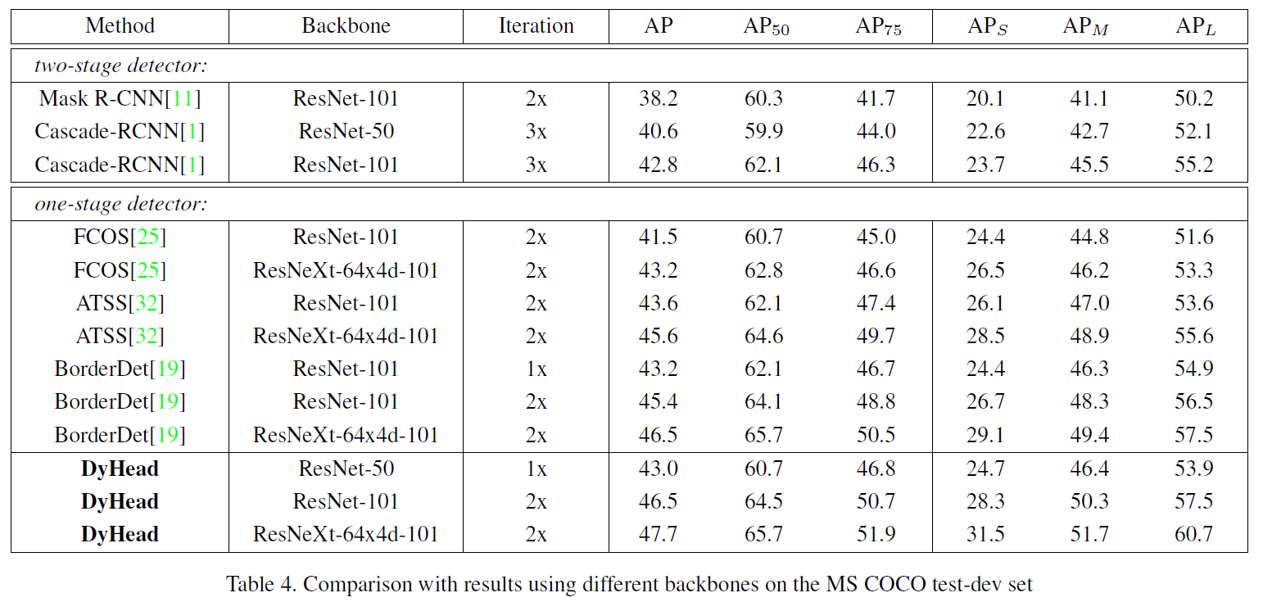
Experiment Results
* DyHead is trained with the ATSS framework
Notes:
If it is not specifically mentioned, dynamic head is trained with the ATSS framework.

Slide 16
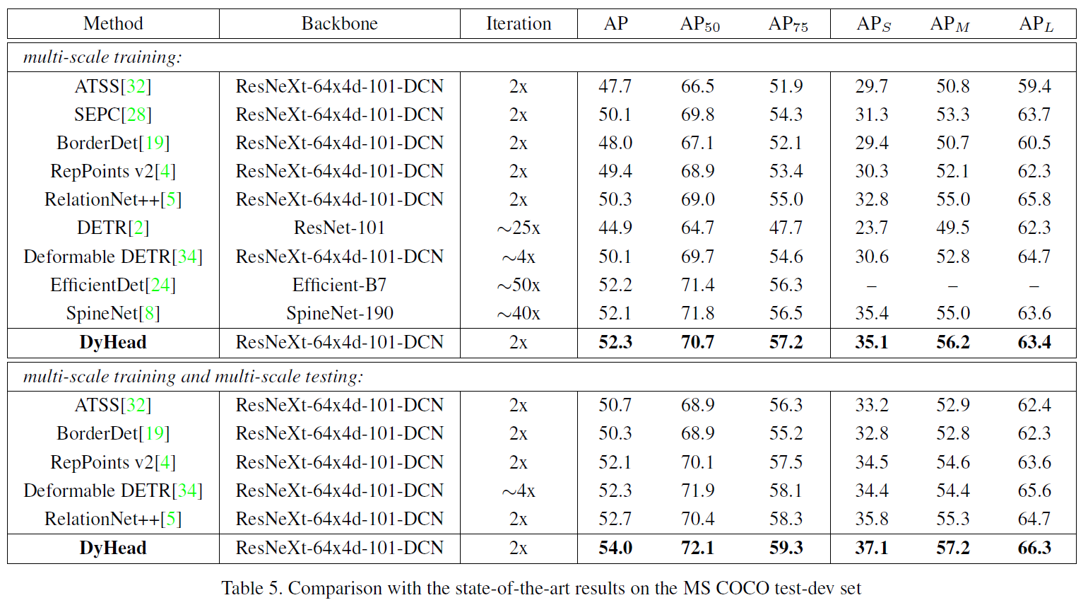
Experiment Results
Method | Backbone | AP
HTC++ | Swin-L | 58.7
DyHead | Swin-L | 60.6
HTC++ | SwinV2-L | 60.8
HTC++ | SwinV2-G | 63.1
Results published on Papers with Code’s COCO test-dev leaderboard
* DyHead is trained with the ATSS framework
Notes:
If it is not specifically mentioned, dynamic head is trained with the ATSS framework.

Slide 17
Conclusion
Object detection dynamic head:
First attempt to combine scale-aware, spatial-aware, and task-aware attentions in one single framework.
Can be applied to various detectors to significantly improve their performance.
Attention block can be improved further with more research.

Slide 18
Thank you for listening

